Slide 1



PRESENTED BY BATCH 2
SMART AIR POLLUTION MONITORING SYSTEM
INSTITUTION: NSRIT
COMPANY: TIERRA AUTOMATIONS

Slide 2






INTRO
Polluted air became the major issue in cities these days due to toxic gases released by
human activities which directly effects
human health. This needs special attention further.
The system we developed uses the gas sensors to detect the presence of harmful gases present in the air and constantly transmits data.

Slide 3



01
02
03
04
Intro
Overview
Components
Blynk
05
Circuit
design
06
Working
07
Further
improvements
08
Our team

Slide 4




PROJECT OBJECTIVES
This device uses a gas sensor which detects harmful gases and calculates the air quality around the particular area.
The mai n_{P}o_{R}b j _{O}e c t_{J}i v_{E}e _{C}i s_{T}t o _{O}m_{B}o n_{J}i t_{E}o r_{C}, a_{T}n_{I}a_{V}l yz_{E}e_{S}a nd log data about air quality to a remote server
and maintain the data over the internet.

Slide 5

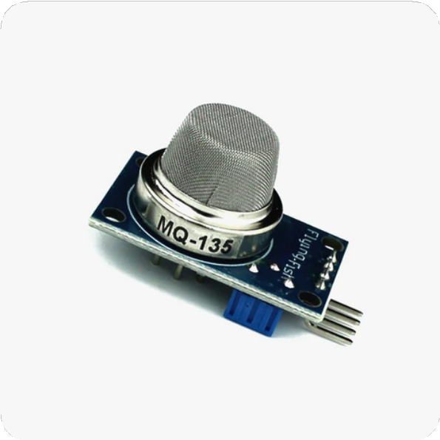
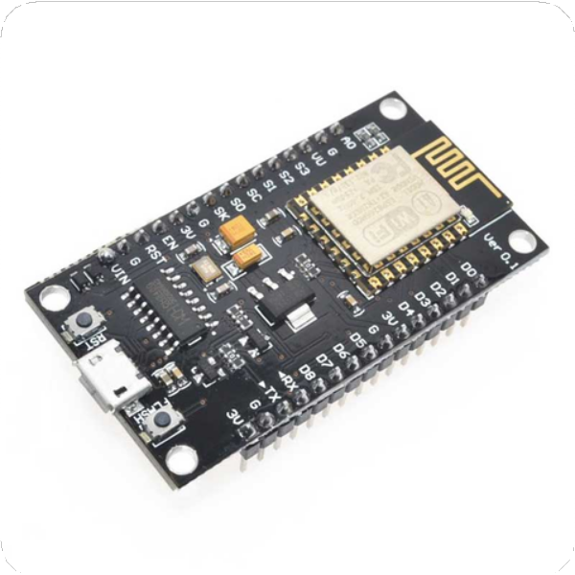

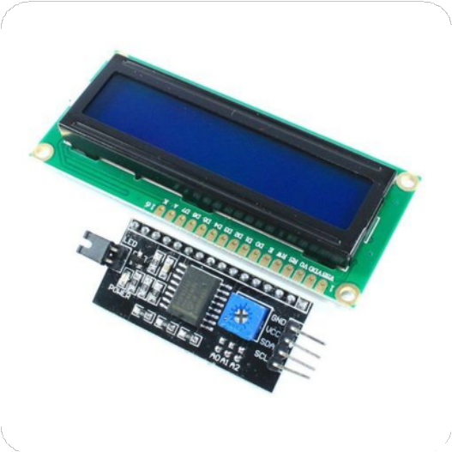
HARDWARE COMPONENTS
SENSOR
MQ- 135 gas sensor
MICROCONTROLLER
ESP8266
DISPLAY
I 2 C LCD

Slide 6


SOFTWARE COMPONENTS
CODE
ARDUINO IDE
BLYNK SOFTWARE

Slide 7


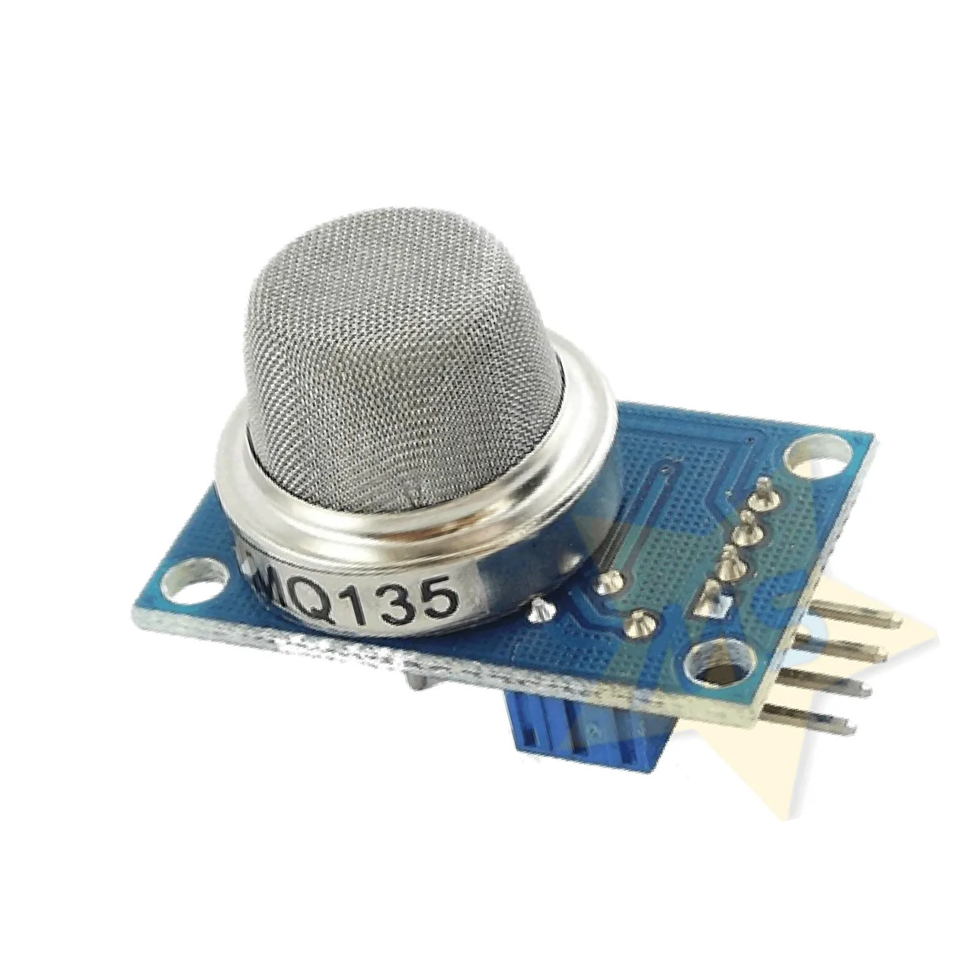


about the components
MQ 135 gas sensor
This gas sensor is used to detect various gases such as alcohol ,benzene , carbon dioxide ,nitrogen dioxide ,etc.. This sensor gives the output in analog format .
This requires some pre-heating before it could give accurate results. This MQ 135 gas sensor is different from other sensors because this is highly sensitive to
Ammonia ,Sulfide and also sensitive to smoke and other harmful gases and the other reason is it is affordable.
MQ 135 configuration:
MQ 135 ESP8266
VCC GND A0
3V GND
A0

Slide 8

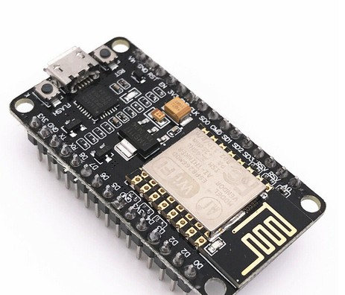
about the components
MICRO CONTROLLER ESP8266
The NodeMCU (Node MicroController Unit) is an open-source software and hardware development environment built around an inexpensive System-on-a-Chip (SoC) called the ESP8266
It contains the crucial elements of a computer: CPU, RAM, networking (WiFi), and even a modern operating system and SDK. That makes it an excellent choice for Internet of Things (IoT) projects of all kinds.
The ESP8266 12-E chip comes with 17 GPIO pins. Not all GPIOs are exposed in all ESP8266 development boards, some GPIOs are not recommended to use, and others have very specific functions.

Slide 9

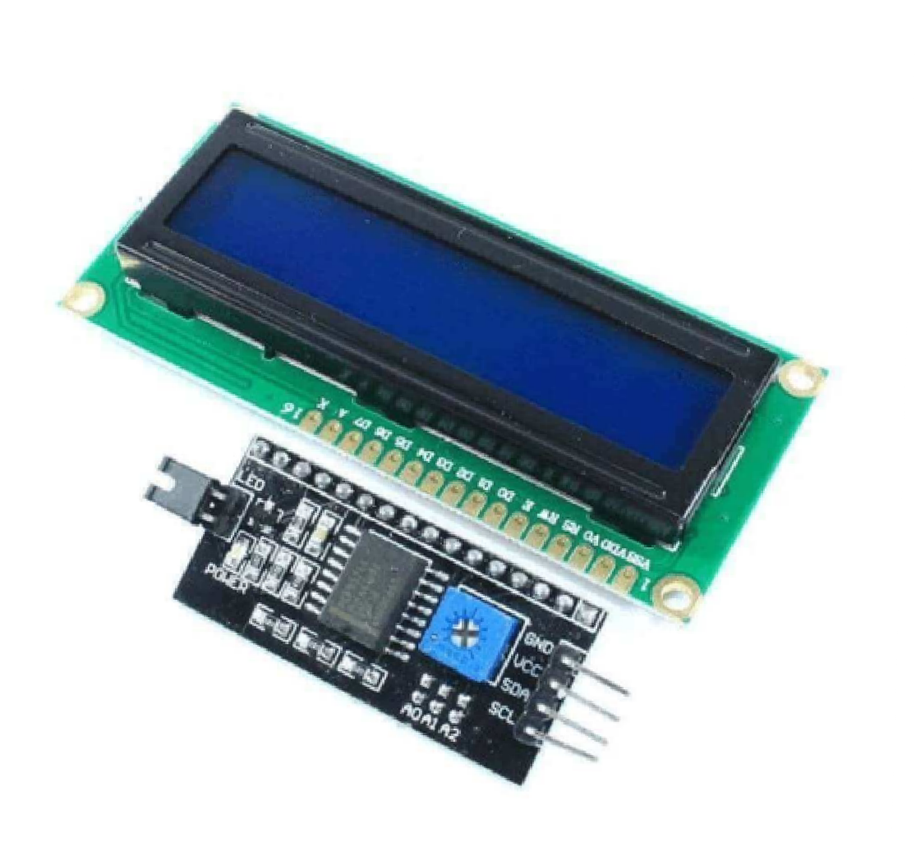
about the components
I2C LCD DISPLAY
Actually ,LCD I2C is composed of a normal LCD ,an I2Cmodule and a potentiometer.
pin out :
LCD I2C uses I2C interface ,so it has 4 pins:
GND Pin: Needs to be connected to GND(0v).
VCC Pin :The power supply for the LCD needs to be connected to the VV(5V). SDA Pin: I2C data signal
SCL Pin: I2C clock signal
I2C CONFIGURATION:
SDA Pin: D2 SCL Pin: D1
since D1 and D2 are best pins

Slide 10

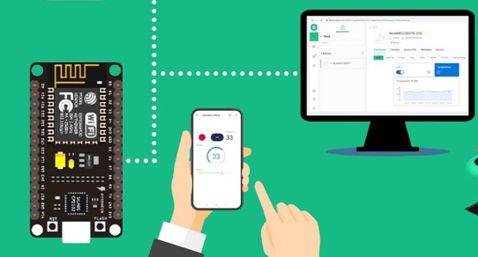
Blynk was designed for the Internet of Things. It can control hardware remotely, it can display sensor data, it can store data, vizualize it and do many other cool things.
Blynk App - allows to you create amazing interfaces for your projects using various widgets we provided.
Blynk Server - responsible for all the communications between the smartphone and hardware. You can use our Blynk Cloud or run your private blynk server locally. It’s open-source, could easily handle thousands of devices and can even be launched on a Raspberry Pi.

Slide 11
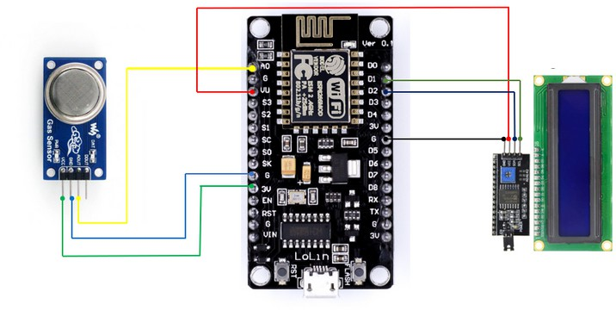
CIRCUIT DESIGN

Slide 12
code:- #include "MQ135.h" #include <SoftwareSerial.h> #define DEBUG true SoftwareSerial esp8266(9,10); // This makes pin 9 of Arduino as RX pin and pin 10 of Arduino as the TX pin const int sensorPin= 0; int air_quality; #include <LiquidCrystal.h> LiquidCrystal lcd(12,11, 5, 4, 3, 2); void setup() { pinMode(8, OUTPUT); lcd.begin(16,2); lcd.setCursor (0,0); lcd.print ("circuitdigest "); lcd.setCursor (0,1); lcd.print ("Sensor Warming "); delay(1000);

Slide 13
Serial.begin(115200); esp8266.begin(115200); // your esp's baud rate might be different sendData("AT+RST\r\n",2000,DEBUG); // reset module sendData("AT+CWMODE=2\r\n",1000,DEBUG); // configure as access point sendData("AT+CIFSR\r\n",1000,DEBUG); // get ip address sendData("AT+CIPMUair_quality=1\r\n",1000,DEBUG); // configure for multiple connections sendData("AT+CIPSERVER=1,80\r\n",1000,DEBUG); // turn on server on port 80 pinMode(sensorPin, INPUT); //Gas sensor will be an input to the arduino lcd.clear(); } void loop() { MQ135 gasSensor = MQ135(A0); float air_quality = gasSensor.getPPM(); if(esp8266.available()) // check if the esp is sending a message { if(esp8266.find("+IPD,")) {

Slide 14
delay(1000); int connectionId = esp8266.read()-48; /* We are subtracting 48 from the output because the read() function returns the ASCII decimal value and the first decimal number which is 0 starts at 48*/ String webpage = "<h1>IOT Air Pollution Monitoring System</h1>"; webpage += "<p><h2>"; webpage+= " Air Quality is "; webpage+= air_quality; webpage+=" PPM"; webpage += "<p>"; if (air_quality<=1000) { webpage+= "Fresh Air"; } else if(air_quality<=2000 && air_quality>=1000) { webpage+= "Poor Air";

Slide 15
} else if (air_quality>=2000 ) { webpage+= "Danger! Move to Fresh Air"; } webpage += "</h2></p></body>"; String cipSend = "AT+CIPSEND="; cipSend += connectionId; cipSend += ","; cipSend +=webpage.length(); cipSend +="\r\n"; sendData(cipSend,1000,DEBUG); sendData(webpage,1000,DEBUG); cipSend = "AT+CIPSEND="; cipSend += connectionId; cipSend += ",";

Slide 16
cipSend +=webpage.length(); cipSend +="\r\n"; String closeCommand = "AT+CIPCLOSE="; closeCommand+=connectionId; // append connection id closeCommand+="\r\n"; sendData(closeCommand,3000,DEBUG); } } lcd.setCursor (0, 0); lcd.print ("Air Quality is "); lcd.print (air_quality); lcd.print (" PPM "); lcd.setCursor (0,1); if (air_quality<=1000) { lcd.print("Fresh Air");

Slide 17
digitalWrite(8, LOW); } else if( air_quality>=1000 && air_quality<=2000 ) { lcd.print("Poor Air, Open Windows"); digitalWrite(8, HIGH ); } else if (air_quality>=2000 ) { lcd.print("Danger! Move to Fresh Air"); digitalWrite(8, HIGH); // turn the LED on } lcd.scrollDisplayLeft(); delay(1000); } String sendData(String command, const int timeout, boolean debug) { String response = "";

Slide 18
} esp8266.print(command); // send the read character to the esp8266 long int time = millis(); while( (time+timeout) > millis()) { while(esp8266.available()) { // The esp has data so display its output to the serial window char c = esp8266.read(); // read the next character. response+=c; } } if(debug) { Serial.print(response); } return response; }

Slide 19




OVERALL PROJECT
SMART AIR POLLUTION MONITORING SYSYTEM
The developed device is set up in a particular environment for which we are checking the air quality.
The device has a Wi-Fi module through which it connects to the network. We would be dumping the code using Arduino IDE software.
In the code itself the configurations and details of the Blynk App are given so that the device is now also connected to the Blynk software.
Now after all the setup, we can now view the Air Quality (ppm) either in the device (I2C LCD) or in the Blynk Dashboard.

Slide 20
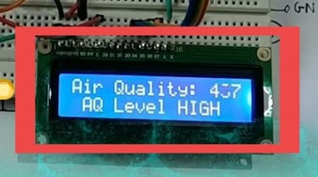
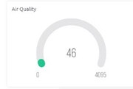
THE RESULT
The air Quality value in ppm can be viewed from time to time in the I2C LCD display board. If the ppm value is far more than safe, we can see an alert displayed on the board.
In the Blynk we create a datastream that displays the Air Quality in ppm over a meter and if there are harmful gases we would be sent a notification on our mobile phones through the app.

Slide 21
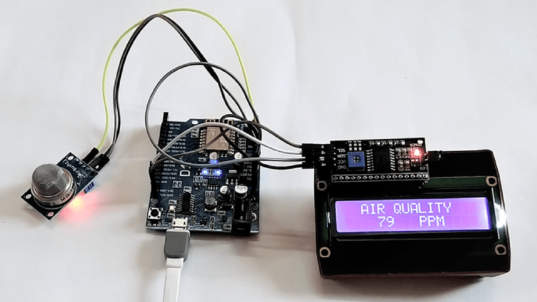





PROJECT IMAGE

Slide 22

PROJECT CONCLUSION
Using this device we can monitor the air quality over a particular area, city or an industry.
As the quality of the air is updated to us from time to time, we could take necessary steps to prevent the pollution.
This particular project can be implemented as an idea in Smart cities.

Slide 23
FURTHER IMPROVEMENTS:
We can improve the project further by adding few other features, Some of them are listed here:
Other gas sensors like MQ-6, MQ-4 can be added to the device to detect other harmful gases also.
An alarm or a Buzzer can be connected so that in case of any alert we would be receiving a sound signal.
Another feature can be said as an extension to the Blynk in which the software sends a mail to the personal mail id in case of any alert.

Slide 24









Our Team
ALICE CROSBY
KIRANMAI
PRASEETHA
GOUS IMAM
NARESH
DINESH
CHANDARA RAO
VENKATA SAI

Slide 25






ANY QUERIES

Slide 26


